Slide 1
Notes:
NOTE TO SCHOOL: Maybe your WOW Ambassadors (or other pupils e.g. Eco Group) could deliver this presentation.

Slide 2
Let’s top the leaderboard!
What?
We’re competing against other schools in our local area and across England by travelling actively to school to be top of the Spring WOW Top Ten leaderboard.
When?
Thursday, 1 February to Thursday, 29 February 2024.
How?
Walk/wheel, cycle, scoot or park and stride to school as much as possible during February and remember to log all of your trips to school on the WOW Travel Tracker.
Why?
Walking to school has many benefits, can you think of any?
Notes:
NOTE TO SCHOOL: Ask pupils to list as many of the benefits of walking to school as they can. Some examples are shown on the next slide.

Slide 3
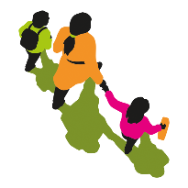
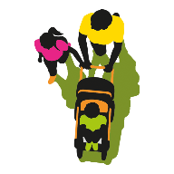
Did you get any of these?
Improves physical and mental health.
Protects the environment, including the air quality around our school.
Reduces congestion outside the school gate and improves safety.
Time to chat with friends and family.
Time to explore your route to school and see the nature around you!

Slide 4
RESOURCES
Engagement guide for teachers and WOW Ambassadors
Social media shareables
Poster
Parents’ letter
Certificates
livingstreets.org.uk/wowtopten
Notes:
NOTE TO SCHOOL: You can point out to staff and pupils that these resources are available and to look out for further information on posters, in a parents/carers letter and in your newsletter/on social media.

Slide 5
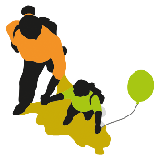
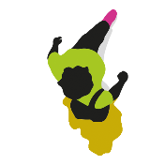
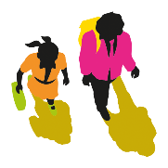
So, remember...
Walk/wheel, cycle, scoot or park and stride as much as possible between Thursday, 1 February and Thursday, 29 February.
Park and Stride means parking the car 10 minutes away from school and walking the rest of the journey.
Record your journey to school on Travel Tracker each day.
The more journeys we record on Travel Tracker, and the more active journeys we make to school, the better our chances of moving up the leaderboard!

Slide 6
Good Luck!

